Slide 1

Producer and Consumer Problem in Java
Java Instructor Committee
Concurrent Programming Team
Xiaoyu Qu
exiaoqu
BID CBC Compass
2018-06-22

Slide 2
Java Cross-host Solution
Message-Queue based distributed solution
In-Memory(NoSQL) DB based distributed solution

Slide 3
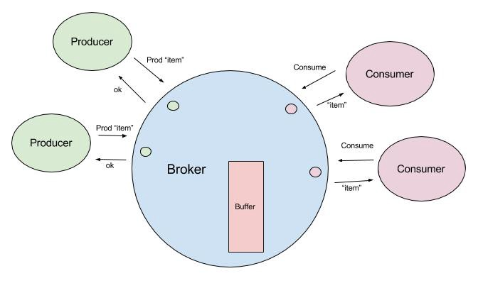
Java Cross-host Solution
Message-Queue based distributed solution
Netty
NIO Non-blocking socket
Message Queue
Kafka Topics
Others, RabbitMQ, ZeroMQ, etc

Slide 4
Java Cross-host Solution
In-Memory(NoSQL) DB based distributed solution
Redis
Nosql

Slide 5
More advanced topics
Data security
Deployment
Non-discard
Multi-hosts(distributed)
Concurrent model
Multi-processes(JVM)
Discard
Multi-threads
Robust
Restore
deadlock
Single-thread
Starving
Live-lock
Dual-buffer
low
Queue buffer
Ring buffer
Ring queue
IPC
MQ
Single-producer and Single-consumer
Broker
DB
Coupling Type
Lock competition
Multi-producers and single-consumer
high
Consumer-side Load-balance
Single-producers and multi-consumers
Performance, respone time
Multi-producers and multi-consumers
Producer-consumer types
Notes:
并发模式：
- Actor模型 Erlang, Scala, Java Akka
- CSP(Communicating Sequential Process)模型： golang

Slide 6
Reference
Producer-consumer problem
Java实现跨线程生产者消费者Solutions
https://blog.csdn.net/u010983881/article/details/78554671
Java并发编程：Synchronized及其实现原理
http://www.cnblogs.com/paddix/p/5367116.html
Java并发编程：Synchronized底层优化（偏向锁、轻量级锁, 重量级锁）
https://www.cnblogs.com/paddix/p/5405678.html

Slide 7
Reference
BlockingQueu介绍：
http://wsmajunfeng.iteye.com/blog/1629354
基于阻塞队列的Java生产者消费者模式:
https://blog.csdn.net/u011486491/article/details/77849326
NIO and MappedByteBuffer
https://blog.csdn.net/huzhigenlaohu/article/details/52488947
https://blog.csdn.net/cloudeagle_bupt/article/details/52136085

Slide 8
Reference
Using IPC with JNA
https://www.cnblogs.com/lanxuezaipiao/p/3635556.html
分布式实现:
https://medium.com/@bizzard4/producer-consumer-the-whole-story-e0b4034406f1
生产消费者模式之深入理解(高级话题)
https://blog.csdn.net/sanyuesan0000/article/details/52996586

Slide 10
生产者/消费者问题 更高级话题
数据安全
部署方式
不丢弃数据
分布式
并发模式
多进程
主动丢弃数据
多线程
可靠性
恢复
单线程
死锁
双缓冲区
低
队列缓冲区
环形数组
单个生产者
单个消费者
环形链表
IPC
MQ
Broker
耦合类型
锁(临界区)竞争
DB
多个生产者
单个消费者
高
消费者负载均衡
单个生产者
多个消费者
性能
多个生产者
多个消费者
生产者消费者模式
Notes:
并发模式：
- Actor模型 Erlang, Scala, Java Akka
- CSP(Communicating Sequential Process)模型： golang

